Slide 1
SWE1010 DIGITAL IMAGE PROCESSING
J-COMPONENT REVIEW

Slide 2
TITLE: MOUSE FUNCTIONALITIES USING HAND GESTURE RECOGNITION
TEAM:
DEEKSHA R – 20MIS1142

Slide 3
Agenda
INTRODUCTION
LITERATURE SURVEY
METHODOLOGY
HARDWARE AND SOFTWARE USED
EXPERIMENTAL RESULTS
CONCLUSION
REFERENCES

Slide 4
INTRODUCTION
With the event technologies within the areas of increased reality and devices that we have a tendency to use in our existence, these devices are getting compact within the variety of Bluetooth or wireless technologies. This paper proposes Associate in Nursing AI virtual mouse system that produces use of the hand gestures and hand tip detection for acting mouse functions within the laptop mistreatment laptop vision. the most objective of the projected system is to perform mouse pointer operates and scroll function employing a internet camera or a integral camera within the laptop rather than employing a ancient mouse device. Hand gesture and hand tip detection by mistreatment laptop vision is employed as a HCI with the PC. With the utilization of the AI virtual mouse system, we are able to track the tip of the hand gesture by employing a integral camera or internet camera and perform the mouse pointer operations and scrolling operate and additionally move the pointer with it.

Slide 5
LITERATURE SURVEY
EXISTING SYSTEM
There are some connected works role out on virtual mouse mistreatment hand gesture detection by carrying a glove within the hand and additionally mistreatment color tips within the hands for gesture recognition, however they're no a lot of correct in mouse functions. the popularity isn't therefore correct attributable to carrying gloves; additionally, the gloves also are not fitted to some users, and in some cases, the popularity isn't therefore correct attributable to the failure of detection of color tips. Some efforts are created for camera-based detection of the hand gesture interface.

Slide 6
PROPOSED SOLUTION
The following describes the overall objectives of this project:
To design to operate with the help of a webcam. The Virtual Mouse application will be operational with the help of a webcam, as the webcam are responsible to capture the images in real time. The application would not work if there are no webcam detected.
To design a virtual input that can operate on all surface. The Virtual Mouse application will be operational on all surface and indoor environment, as long the users are facing the webcam while doing the motion gesture.
To program the camera to continuously capturing the images, which the images will be analyzed, by using various image processing techniques. As stated above, the Virtual Mouse application will be continuously capturing the images in real time, where the images will be undergo a series of process, this includes HSV conversion, Binary Image conversion, salt and pepper noise filtering, and more.
To convert hand gesture/motion into mouse input that will be set to a particular screen position.

Slide 7
METHODOLOGY
HSV conversion, Binary Image conversion, salt and pepper noise filtering, and more.

Slide 8
HARDWARE AND SOFTWARE USED
Hardware Components-
Computer System.
Web Camera.
Software Components-
Anaconda Application.

Slide 9
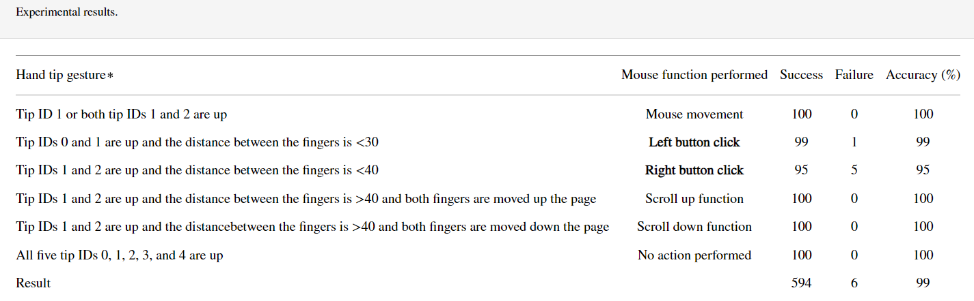
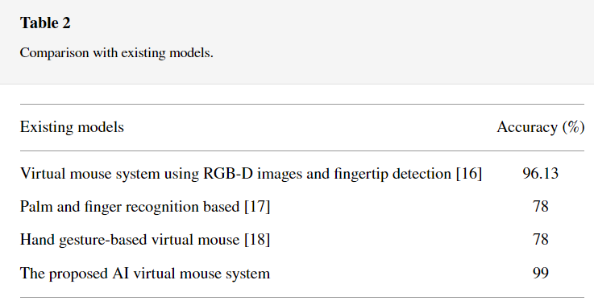
EXPERIMENTAL RESULTS

Slide 10
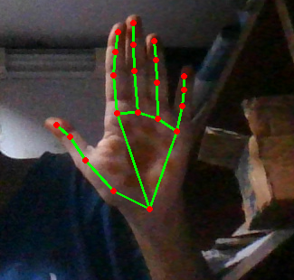
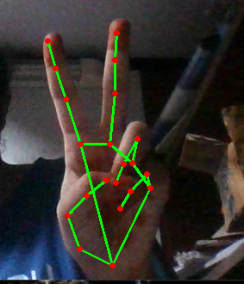

Slide 11
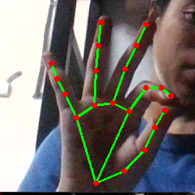
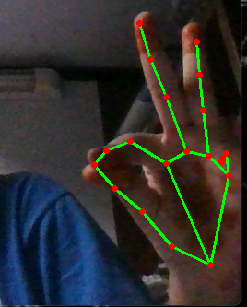
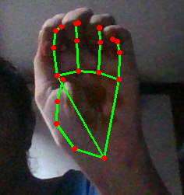

Slide 12
CONCLUSION
From Table, it will be seen that the planned AI virtual mouse system had achieved associate degree accuracy of concerning ninety nine. From this ninety nine accuracy of the planned AI virtual mouse system, we have a tendency to come back to grasp that the system has performed well. As seen in Table, the accuracy is low for “Right Click” as this can be the toughest gesture for the pc to know. The accuracy for right click is low as a result of the gesture used for acting the actual mouse perform is tougher. Also, the accuracy is extremely smart and high for all the opposite gestures. Compared to previous approaches for virtual mouse, our model worked o.k. with ninety nine accuracy. The graph of accuracy is shown.
From Table a pair of, it's evident that the planned AI virtual mouse has performed o.k. in terms of accuracy compared to the opposite virtual mouse models. The novelty of the planned model is that it will perform most of the mouse functions like left click, right click, scroll up, scroll down, and mouse pointer movement victimization finger tip detection, and also, the model is useful in dominant the laptop sort of a physical mouse however within the virtual mode. Figure fifteen shows a graph of comparison between the models.

Slide 13
REFERENCES
https://www.hindawi.com/journals/jhe/2021/8133076/tab1/
https://www.hindawi.com/journals/jhe/2021/8133076/
https://www.ijraset.com/research-paper/ai-virtual-mouse-using-hand-gesture-recognition
https://app.diagrams.net
https://github.com/xenon-19/Gesture-Controlled-Virtual-Mouse
https://youtu.be/ufm6tfgo-OA

Slide 14
Thank You

